Slide 1






CacheQuote: Efficiently Recovering Long-term Secrets of SGX EPID via Cache Attacks
September 11th 2018
CHES, Amsterdam, The Netherlands
Fergus Dall, Gabrielle De Micheli, Thomas Eisenbarth, Daniel Genkin, Nadia Heninger, Ahmad Moghimi,
and Yuval Yarom

Slide 2



Intel Software Guard Extensions
Mail
Data …
Set of instructions aiming to guarantee confidentiality and integrity of applications that run inside untrusted environments.
Protects enclaves of code and data.
Notes:
SGX allows users to perform secure computations on potentially compromised platforms where an attacker controls everything, even the OS.

Slide 3
Enclaves
A
Enclave
code
data
Enclaves are isolated from the software running on the computer.
SGX controls the entry to and exit from enclaves.
Application
OS

Slide 4





Remote attestation: EPID
quote
Intel
SGX
Trust me !
Shared secret
EPID key
Client
Verification by
Intel
Intel Attestation
Service
Trust is based on the EPID key!
Why need IAS ? Revocation !
All quotes are encrypted by SGX.
Notes:
Now, we are in the situation where we want to put the enclave on the cloud.
So we have the following setup with an SGX machine on the cloud and a client.
The client : communicating with enclaves : correctly initialized : run on trusted servers.
So the cloud needs to prove to the client that it is running genuine SGX hardware.
= remote attestation protocol implemented inside SGX, EPID.
proof = cryptographic signature that will certify the enclave’s content.
Every SGX machine has an attestation key, given by Intel.
When the cloud launches the enclave, it uses special SGX instructions and this attestation key to hash and sign the enclave’s content. This is called an attestation quote.

Slide 5



Unlinkability
impossible to identify the platform that produced a signature on some message $m.$
Notes:
The red processor can generate a quote, after the quote is send to the network, there is no way to distinguish this quote from other quotes.

Slide 6


Unforgeability
impossible for an attacker to forge a valid signature on some previously-unsigned message, without knowing a non-revoked secret key.
m
$$σ$$
NO!

Slide 7
Our results
First cache attacks on Intel’s EPID protocol implemented inside SGX.
Recover part of the enclave’s long term secret key.
Malicious attestation server (Intel) can break the unlinkability guarantees of SGX’s remote attestation protocol.
Notes:
TRANSITION: To show you how the address works, I’ll give background on EPID….

Slide 8



EPID: setup
An issuer:
A revocation manager:
A platform$:$
A verifier$:$
Notes:
Verifier AND in our case it is is Intel

Slide 9







EPID: algorithms
$$1^{k}$$
Setup
Join
Sign
Verify
$$(gpk, isk)$$
issuer
$$(gpk, isk)$$
$$sk$$
$$gpk$$
platform
platform
m, sk
$$σ$$
$$σ$$
Verifier
platform
Client
Yes/No
Verifier
Notes:
Revocation manager revoke platforms whose keys and signature are compromised.

Slide 10
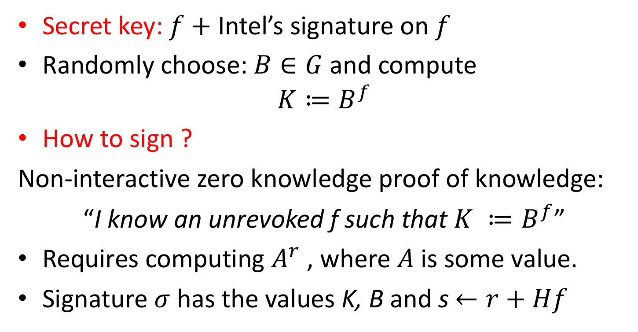
The signing algorithm
Secret key: $f+$Intel’s signature on $f$
Randomly choose: $B∈G$ and compute
$$K≔B^{f}$$
How to sign ?
Non-interactive zero knowledge proof of knowledge:
“I know an unrevoked f such that $K ≔B^{f}$”
Requires computing $A^{r}$ , where $A$ is some value.
Signature $σ$ has the values K, B and s $←r+Hf$
Notes:
G is defined as part of the scheme group public key gpk
Unlinkability → zero knowledge proof

Slide 11
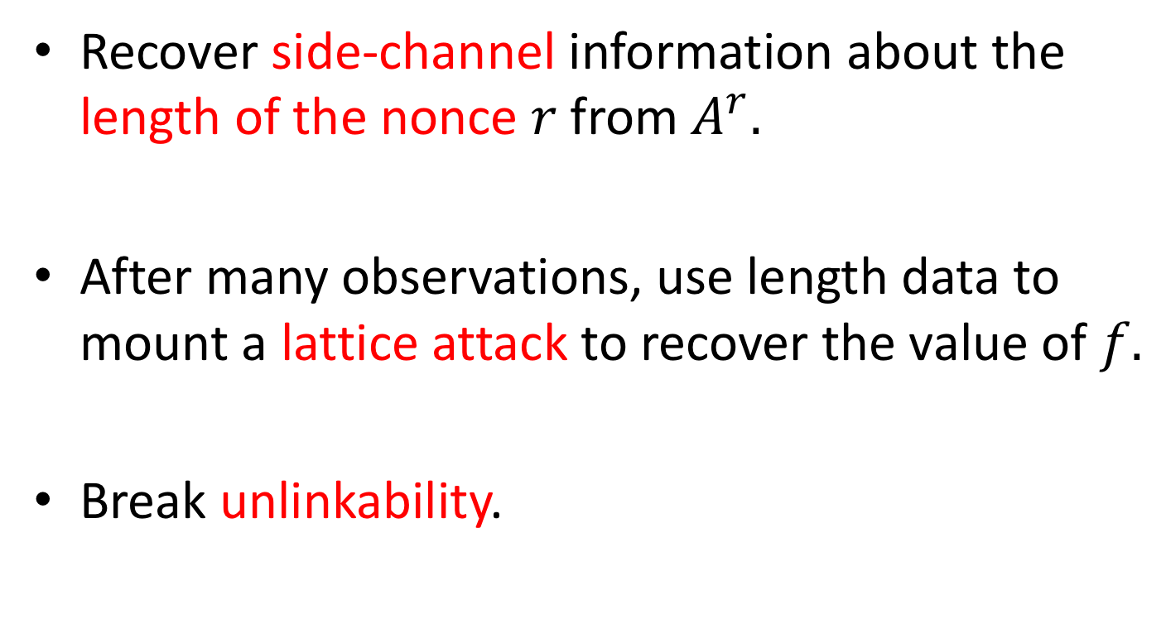
Attack idea
Recover side-channel information about the length of the nonce $r$from $A^{r}.$
After many observations, use length data to mount a lattice attack to recover the value of $f.$
Break unlinkability.

Slide 12
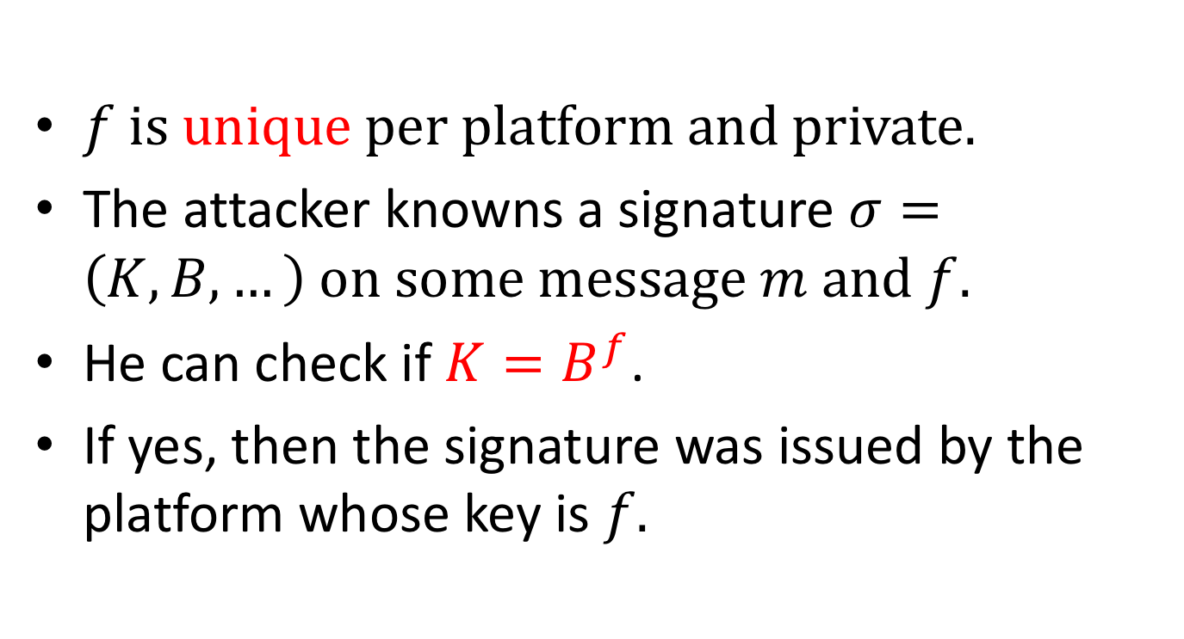
How unlinkability is broken?
$f is unique per platform and private.$
The attacker knowns a signature $σ=\left(K, B, …\right) on some message m and f.$
He can check if $K=B^{f}$.
If yes, then the signature was issued by the platform whose key is $f.$
Notes:
Attack can only be done by Intel because quotes are encrypted by Intel.

Slide 13
CPU vs memory
Caches are used to bridge the gap.
Divides memory into lines
Stores recently used lines
In a cache hit, data is retrieved from the cache
In a cache miss, data is retrieved from memory and inserted to the cache
Processor
Cache
Memory
Notes:
Consequence gap : processor reads from memory it needs to wait -> fast processor that mostly waits for the memory.
bridge this gap, processor designers small bank of memory called "cache" between main memory and the processor: small, closer to the execution core, more expensive technologies.
Cache divides memory into units called lines. When the processor accesses memory the cache brings the line that contains the requested data from memory and provide the data to the processor. At the same time, it also stores a copy of the data.

Slide 14


The Prime+Probe Attack
Allocate a cache-sized memory buffer
Prime: fills the cache with the contents of the buffer
Probe: measure the time to access each cache set
Slow access indicates victim access to the set
Memory
Notes:
exploit this cache behaviour.
spy wants to learn information about the victim's memory accesses
spy then primes the caches. It accesses each memory line in the buffer, bringing the memory lines to the cache.
the victim has to bring the data from memory, and it will evict some of the spy's data.
After waiting, the spy probes the cache : measuring the time it takes to read
By repeating this Prime and Probe cycle, the spy can create a trace of the victim's behaviour over time.

Slide 15
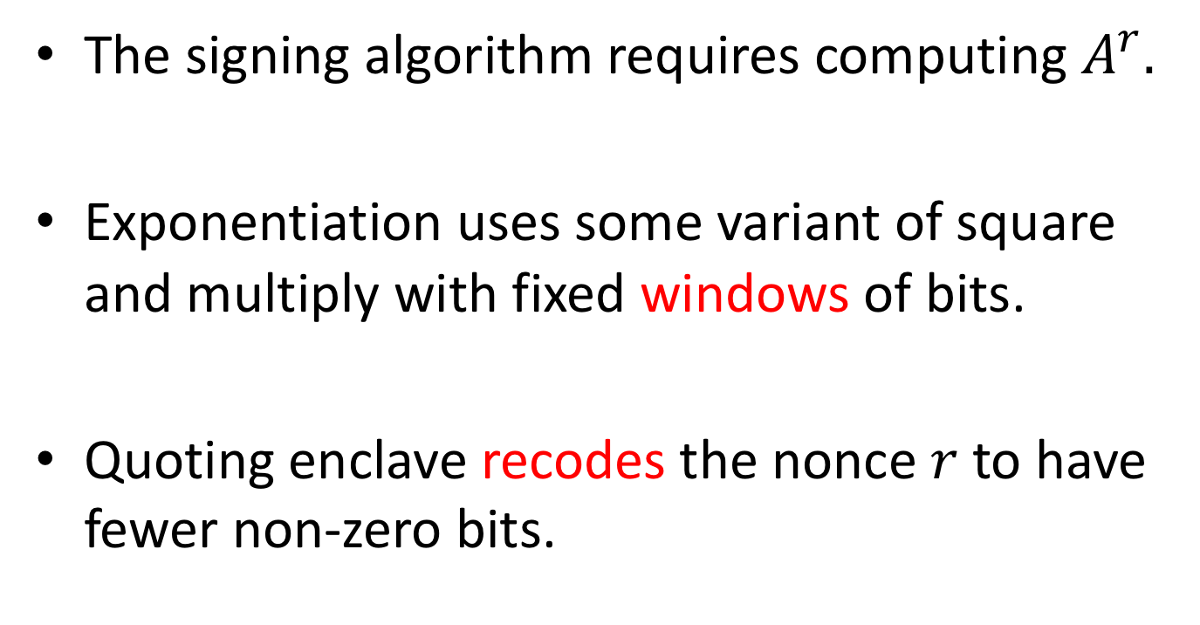
In our attack
The signing algorithm requires computing $A^{r}.$
Exponentiation uses some variant of square and multiply with fixed windows of bits.
Quoting enclave recodes the nonce $r$to have fewer non-zero bits.

Slide 16

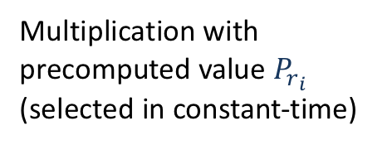


Scalar multiplication algorithm
MultPoint(point $P$, window size $w$, scalar $r$):
Initialize $P :P_{0}←O$
For $i←1$ to $2^{w−1}$ do:
$P_{i}←P⋅P_{i−1}$
$$i←max⁡(j :r_{j}≠0)$$
$$s←P_{r_{i}}$$
$$i←i−1$$
While $i≥0$ do:
$s←r^{2^{w}}$
$s←s⋅P_{r_{i}}$
$i←i−1$
End while
Output: $s$
Start with MSB $≠0$
$w$ squaring operations
Main loop
Multiplication with precomputed value $P_{r_{i}}$ (selected in constant-time)
Scalar of length 256 bits recoded scalar of length 52 51 loop iterations.
Bits 256 and 255 are 0 recoded scalar of length 51 50 loop iterations.

Slide 17
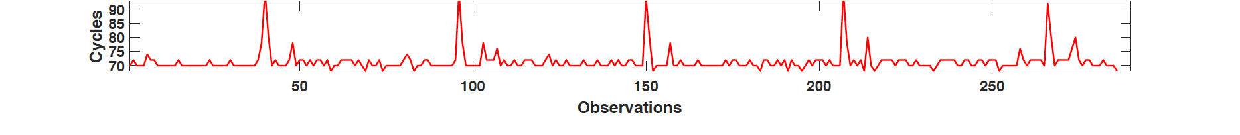
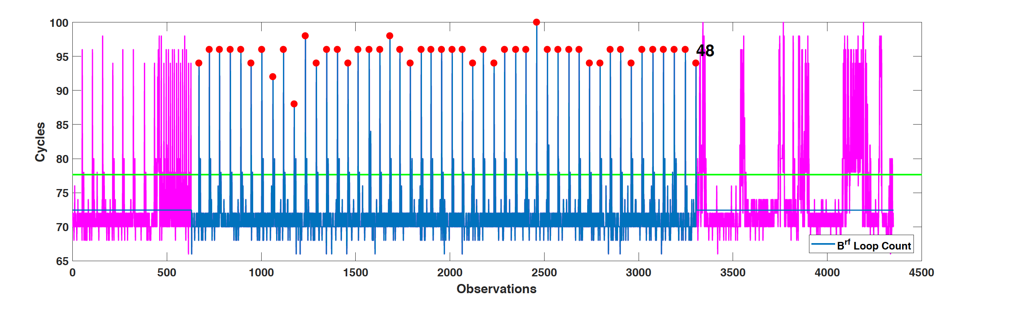
Counting loops
Monitor cache access patterns during the computation of the main
loop.
One period corresponds to one loop iteration.
Number of periods gives us information on the number of iterations.
Notes:
spike = moment when something is being evicted from the cache.
The constant periods correspond to the loop iterations.

Slide 18
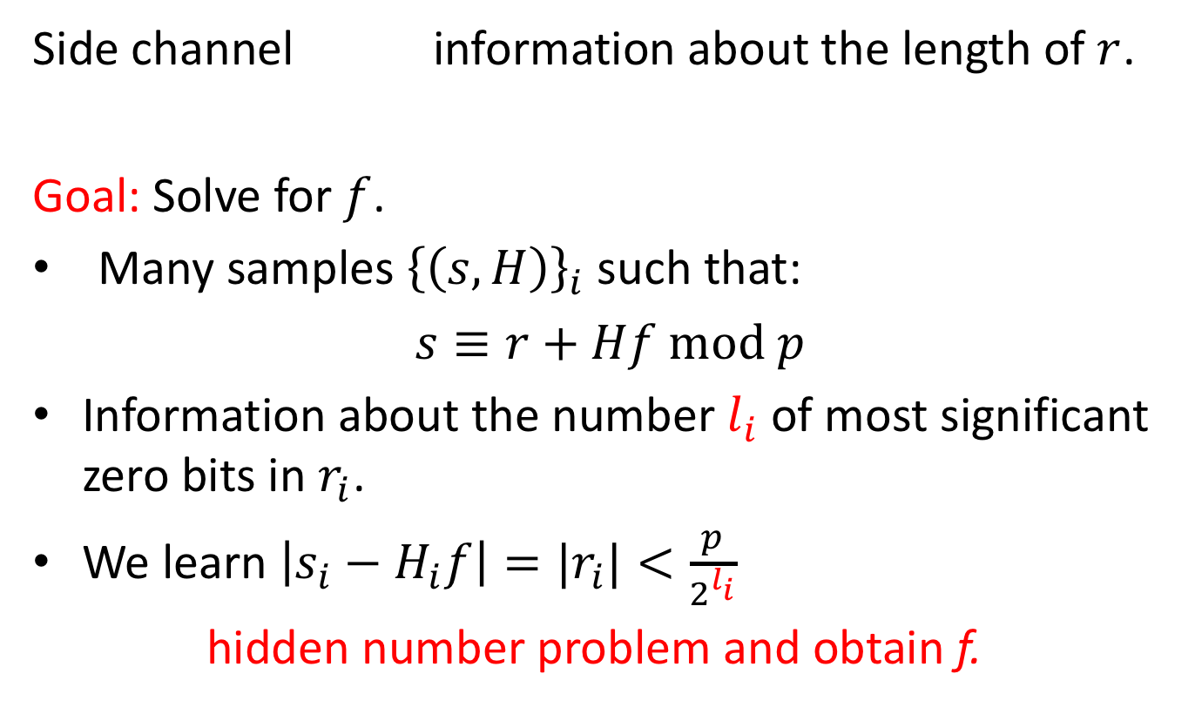
A lattice attack
Side channel information about the length of $r$.
Goal: Solve for $f$.
Many samples ${\left\{\left(s, H\right)\right\}}_{i}$ such that:
$s≡r+Hf mod p$
Information about the number $l_{i}$ of most significant zero bits in $r_{i}$.
We learn $\left|s_{i}−H_{i}f\right|=|r_{i}|<\frac{p}{2^{l_{i}}}$
hidden number problem and obtain f.
Notes:
r has leading zeros, so it’s small, and so |r| < … where 2^l is the number of leading zeros

Slide 19
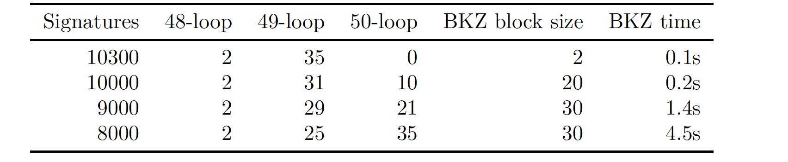
Recovering f
10 600 signatures required if only using 49-loop samples to get 37 error-free samples.
Use samples of different loop lengths
Reduce the number of signatures with manual inspection: less than 7 500 observed
signatures to obtain enough 49-loop observations for a full key recovery.

Slide 20
Conclusion
We finally have f.
Limitations: we can’t run the attack ourselves as all the EPID signatures are encrypted with Intel’s public key !
A malicious Intel could break the unlinkability guarantee.
Thank you !

Slide 21
Thank you !
CacheQuote: Efficiently Recovering Long-term Secrets of SGX EPID via Cache Attacks
Fergus Dall, Gabrielle De Micheli, Thomas Eisenbarth, Daniel Genkin, Nadia Heninger, Ahmad Moghimi, and Yuval Yarom

Slide 22
Key recovery with the hidden number problem
In our experiments, 8000 signatures necessary to enough error-free samples for key recovery.
Notes:
CHANGE

Slide 23
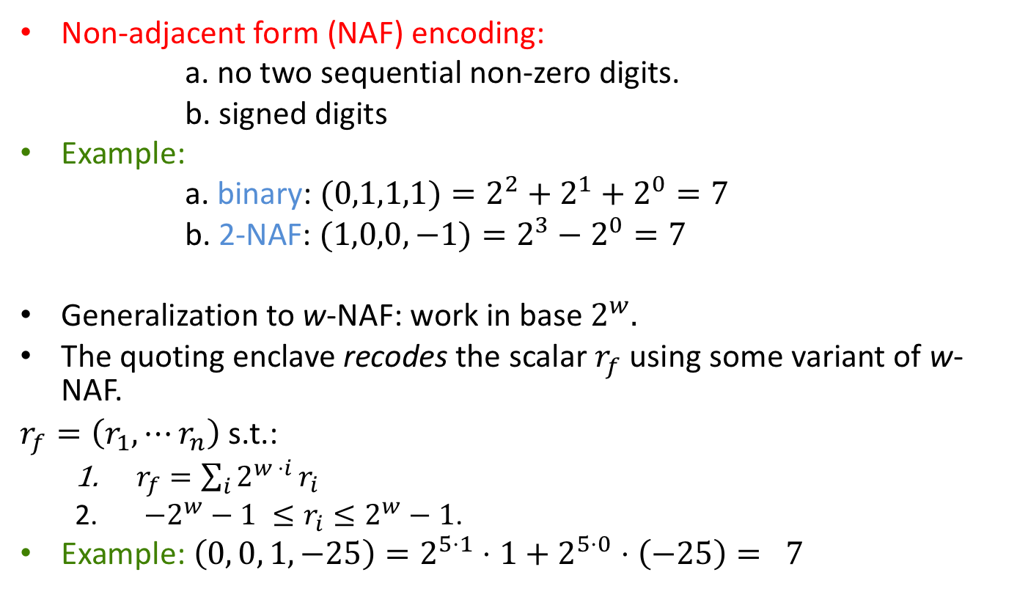
Recoding the nonces
Non-adjacent form (NAF) encoding:
a. no two sequential non-zero digits.
b. signed digits
Example:
a. binary: $(0,1,1,1)=2^{2}+2^{1}+2^{0}=7$
b. 2-NAF: $(1,0,0,−1)=2^{3}−2^{0}=7$
Generalization to w-NAF: work in base $2^{w}.$
The quoting enclave recodes the scalar $r_{f}$ using some variant of w-NAF.
$r_{f}=\left(r_{1},⋯r_{n}\right)$ s.t.:
$r_{f}=\sum_{i}{2^{w ⋅i }r_{i}}$
$−2^{w}−1 ≤r_{i}≤2^{w}−1$.
Example: $\left(0, 0, 1, −25\right)=2^{5⋅1}⋅1+2^{5⋅0}⋅\left(−25\right)= 7$

